Slide 1
Circuit Properties

Slide 2
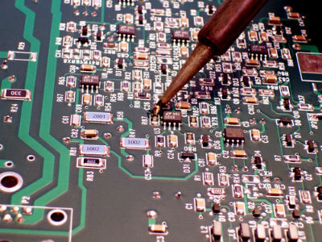
In this Smart Lesson you will revise some basic principles, including learning to:
Draw a circuit diagram.
Symbolise components of circuits.
Recall definitions of current, resistance and voltage.

Slide 3
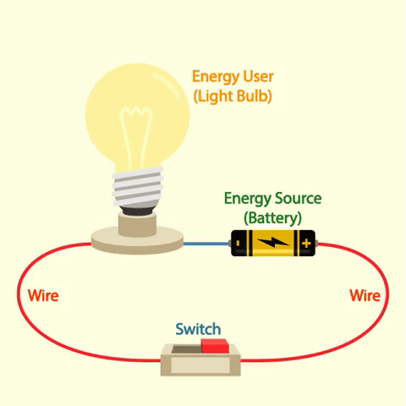
A circuit is a loop of wire which connects an energy source to an energy user.
The energy source is usually a battery. However, it could also be a generator.
The energy user is an object that needs the energy from the energy source. Some common energy users are light bulbs, heating elements and motors.

Slide 4

A torch is a great example of a simple circuit.
In a torch, the energy source is the battery and the energy user is the light bulb.
Remember: These two circuit components are joined by wires.

Slide 5
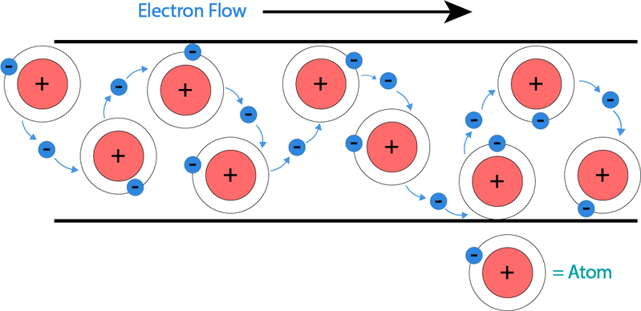
The components of every circuit are joined by wires.
We need to use wires in circuits so that electrons can flow between circuit components.
These moving electrons transfer energy from the energy source to the energy user.

Slide 6
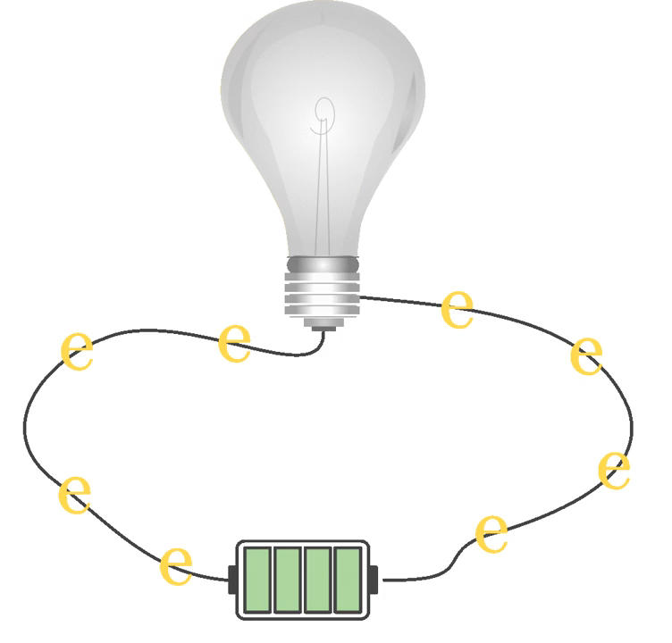
An energy source can be a tiny battery or a huge generator!
The energy source provides the electrons with the energy they need to flow around the circuit.
The electrons are already in the wire. The energy source just pushes them around the circuit.

Slide 7
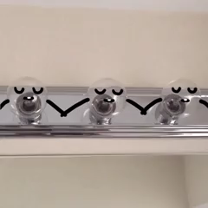
The electrons transfer energy from the energy source to the energy user.
The energy user then transforms the energy into a useful form.
For example, a light bulb would transform the electrical energy of the electrons into light energy.

Slide 8
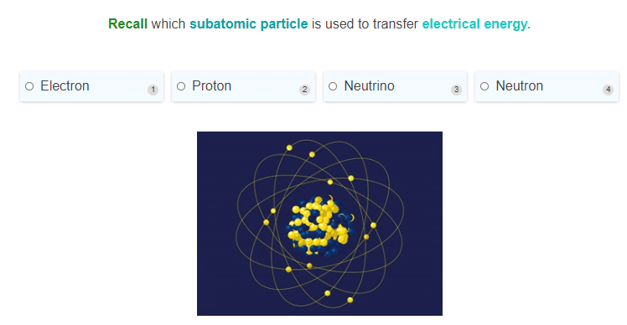

Slide 9
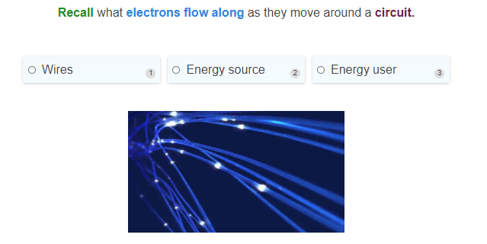

Slide 10
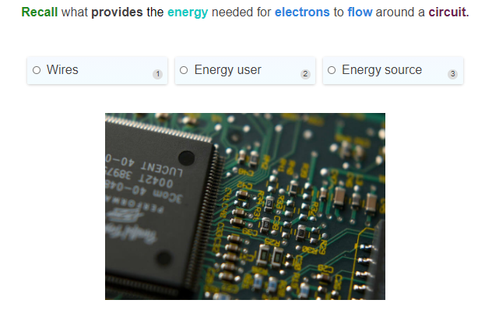

Slide 11
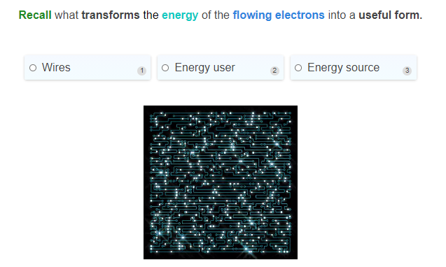

Slide 12


Slide 13
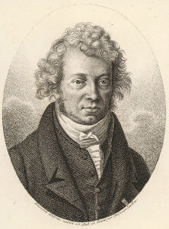
What is current?
Electrical current is the flow of electrical charge.
The unit of current is Amps (A) or more correctly, Amperes, named after the French physicist André-Marie Ampère.
The symbol for current is I.
Current is measured with an ammeter used in series with the components.
Current is calculated using the formula: I=q/t​, where q is the charge in Coulombs and t is the time in seconds.

Slide 14
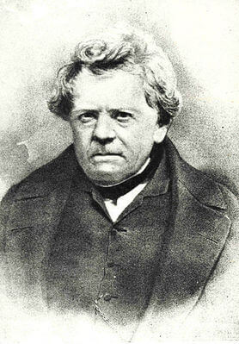
What is resistance?
Resistance is defined as the ratio of the voltage applied to the electric current that flows through it.
It is an inherent property of a material that resists the flow of electric current.
Resistance is measured in Ohms (Ω), named after the German physicist, Georg Simon Ohm.
The resistance of a wire increases with length of the wire, but decreases as the thickness increases.

Slide 15
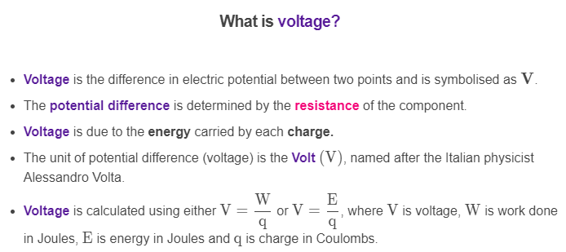

Slide 16
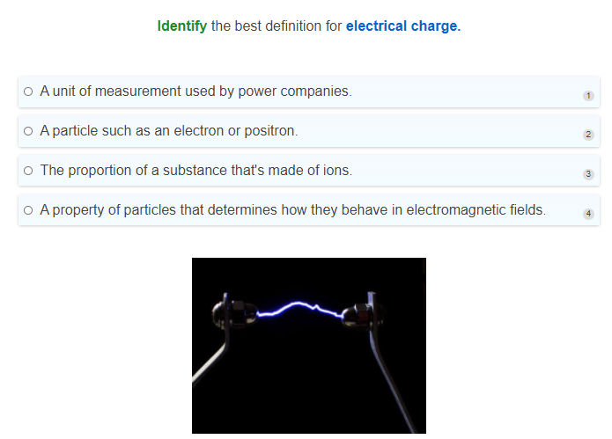

Slide 17
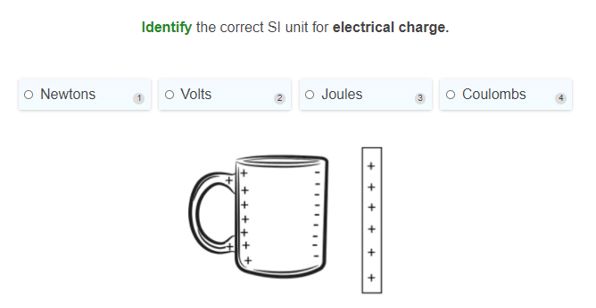

Slide 18
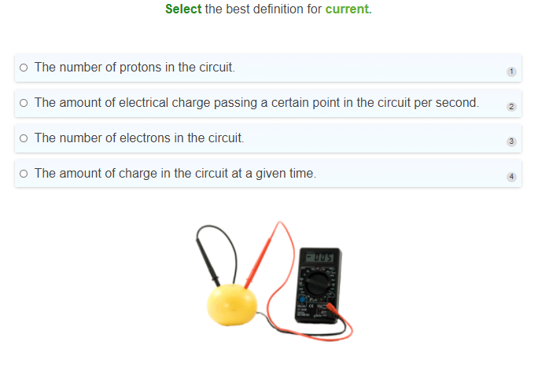

Slide 19
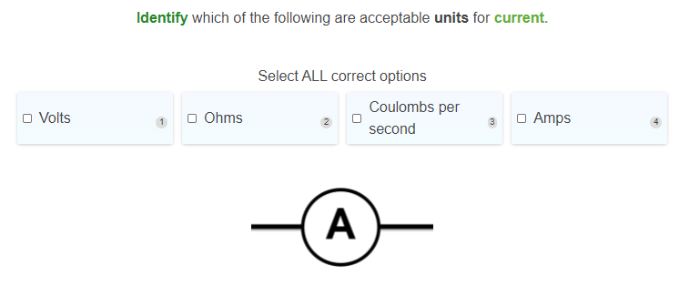

Slide 20
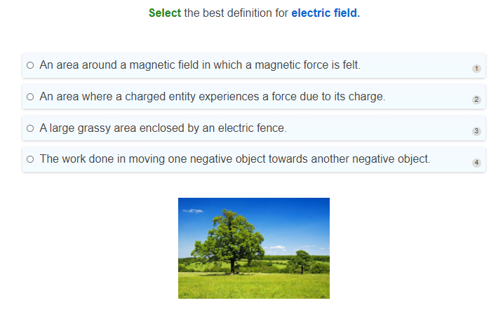

Slide 21
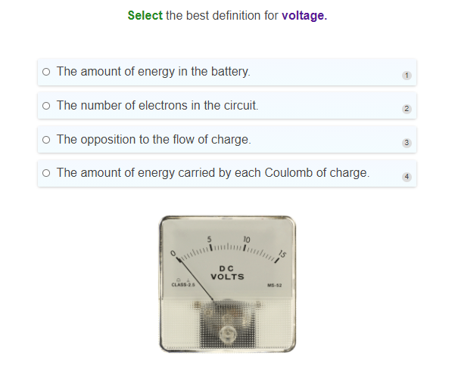

Slide 22
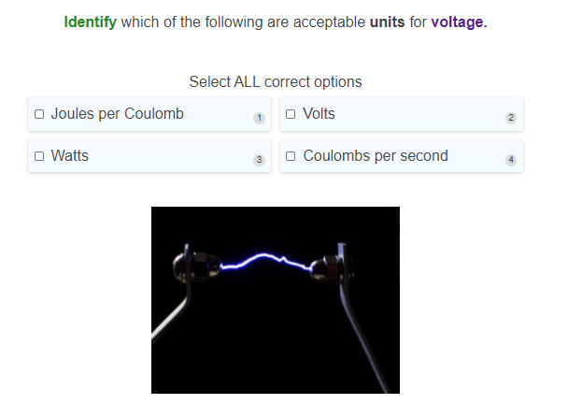

Slide 23
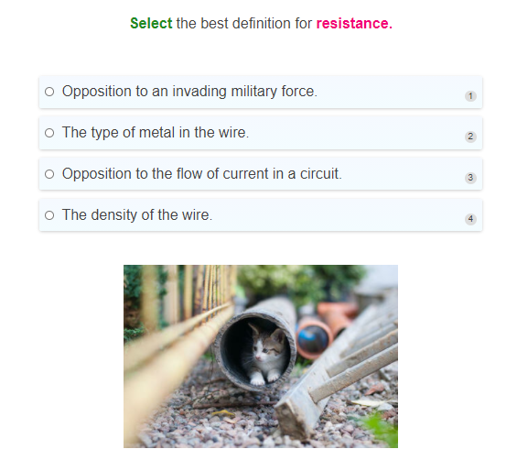

Slide 24
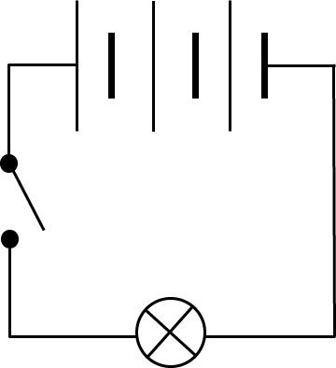
We can represent circuits and their components with circuit diagrams.
There are a few important circuit components that you need to know the symbols for.
This will allow you to draw circuit diagrams.

Slide 25

The first important circuit component is the wire.
It is represented by a straight line.
When you draw a circuit diagram, you must make sure that the circuit components are connected by a wire.

Slide 26
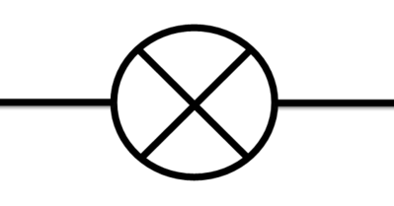
Light bulbs and LED lights are very common circuit components.
Light bulbs are represented by a circle with an X through the middle. Notice how straight lines on either side of the light bulb represent the wires connecting it to the rest of the circuit.

Slide 27
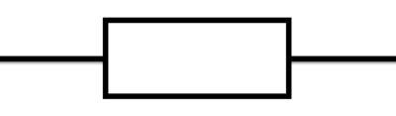

We try to keep the symbols for circuit components as simple as possible to make drawings clear.
A resistor is an object which resists the flow of electrons.
It can be represented by either a box or a zigzag line.

Slide 28
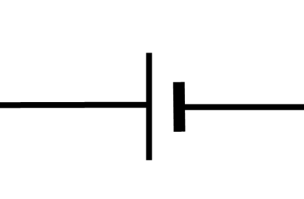

A cell is a type of energy source.
It is represented by two lines, one of which is longer than the other. The longer side is the positive terminal (+) and the shorter side is the negative terminal (−).
A battery is made out of several cells which are joined together.
A battery may be drawn as shown below, or it could be represented by a two cells connected by a dotted line.

Slide 29
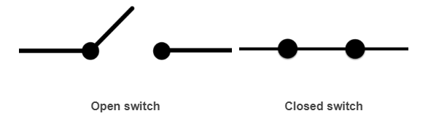
Many household circuits have switches.
When a switch is closed, it allows electrons to flow across it. Electrons are not able to flow across an open switch because the circuit is broken.

Slide 30
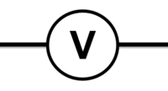
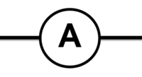
The final circuit component symbols which you need to know about are ammeters and voltmeters.
Ammeters measure the current flowing through a circuit. Ammeters are represented by a circle with an "A" in the middle.
Voltmeters measure the voltage supplied to a circuit. Voltmeters are represented by a circle with a "V" in the middle.
We will learn more about ammeters and voltmeters in the upcoming lessons.

Slide 31
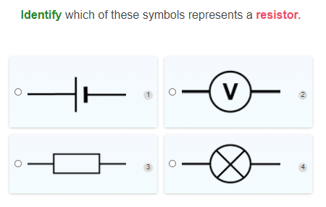

Slide 32
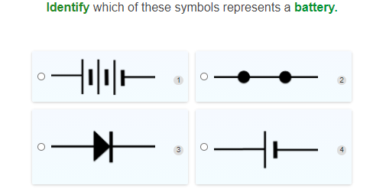

Slide 33
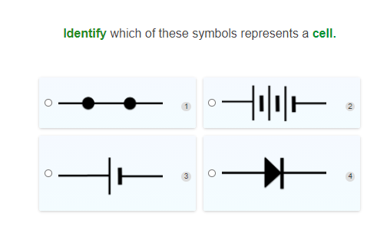

Slide 34
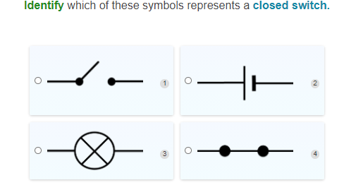

Slide 35
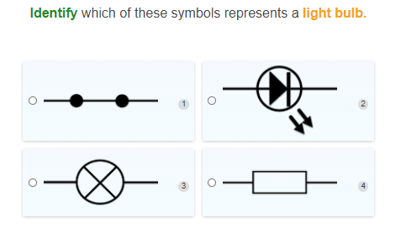

Slide 36
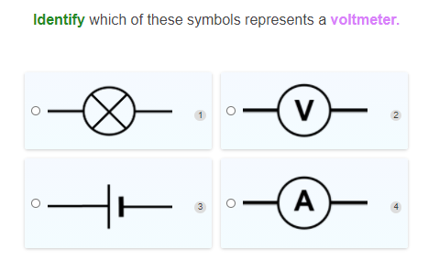

Slide 37
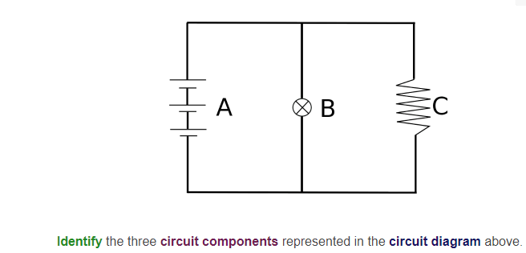

Slide 38
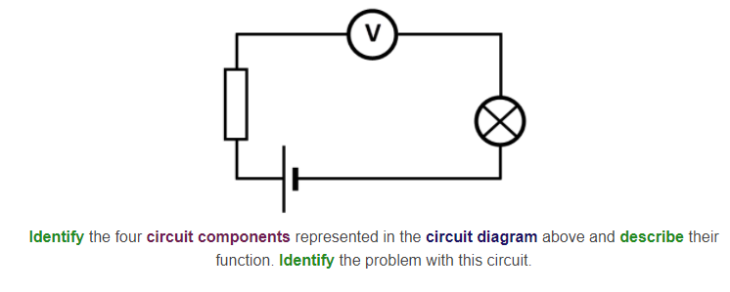

Slide 39
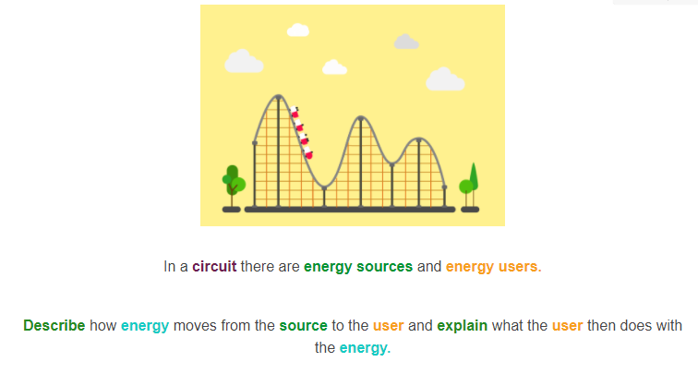

Slide 40
